Slide 1

DAYANANDA SAGAR COLLEGE OF ENGINEERING,
SHAVIGE MALLESHWARA HILLS, K.S. LAYOUT, BANGALORE -560078.
DEPARTMENT OF COMPUTER SCIENCE AND ENGINEERING
CLOUD AND BIG DATA LAB MINI PROJECT
APP REVIEW ANALYSIS
Team 56 Members :-
1. 1DS18CS065- MAHIMA P
2. 1DS18CS108- RUSHANG S
3. 1DS18CS117- SHEFALI AGARWAL
Under the Guidance of
Prof. RAVICHANDRA & Prof. ANITHA M
Assisstant Professor, Dept of Computer Science and Engineering, DSCE

Slide 2
ABSTRACT
Our project focuses on giving a score based on a dataset-which is the reviews left by other people.A set of different english words and their sentiment score with a specific range is used.
Ideally, you would want to collect every possible review and work with that. However, in the real world data is often limited (too large, inaccessible, etc). So, the number of reviews used are limited.
Lucky for us, Google Play has plenty of apps, reviews, and scores. We can scrape app info and reviews using the google-play-scraper package.You can choose plenty of apps to analyze. But different app categories contain different audiences, domain-specific quirks, and more. We’ll start simple.We want apps that have been around some time, so opinion is collected organically. We want to mitigate advertising strategies as much as possible. Apps are constantly being updated, so the time of the review is an important factor.

Slide 3
INTRODUCTION
We spend a lot of time on our phone these days and inevitably end up using many applications.Google PlayStore is by far the largest app store in the world.Before downloading any app,we always look at the reviews to get a feel for what we are trusting our data and memory space with.
Ratings are an efficient way to get a quick look at how an app is,but they never give the complete picture.A review analysis system can help with this,in addition to providing the advantage that reviews are simply harder to fake.

Slide 4
PLATFORMS USED
PySpark: PySpark is an interface for Apache Spark in Python. It not only allows you to write Spark applications using Python APIs, but also provides the PySparkshell for interactively analyzing your data in a distributed environment.
Google Colab: Colaboratory, or “Colab” for short, is a product from Google Research. Colab allows anybody to write and execute arbitrary python code through the browser, and is especially well suited to machine learning, data analysis and education.
Google Play Scraper:The google-play-scraper is a Node. js module that helps in scraping App data from the Google Play store by providing methods that make our job easy.
PyTorch:PyTorch is an open source machine learning library based on the Torch library, used for applications such as computer vision and natural language processing, primarily developed by Facebook's AI Research lab.

Slide 5
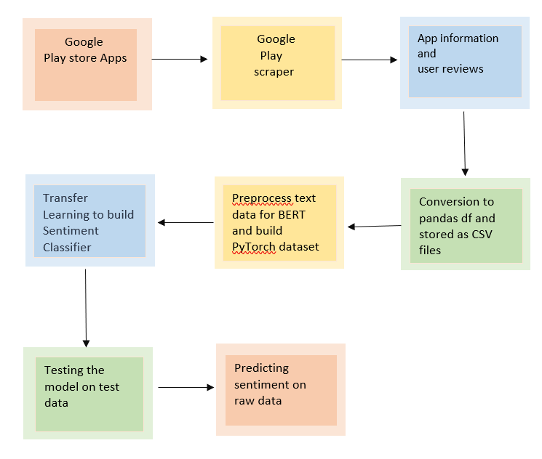
DESIGN AND IMPLEMENTATION
Fig: Flowchart showing working of the model

Slide 6
DESIGN AND IMPLEMENTATION
The implementation of the project involves two steps:
Creating a dataset for Sentiment Analysis by scraping google play app information and reviews using python.
In this step, we set the goals and expectations for the dataset.
Using the Google-play-scraper available on GitHub, we scrape the google play app information.
We scrape user reviews for google play store apps.
We’ll store the app information by converting the JSON objects into a Pandas dataframe and saving the result into a CSV file.

Slide 7
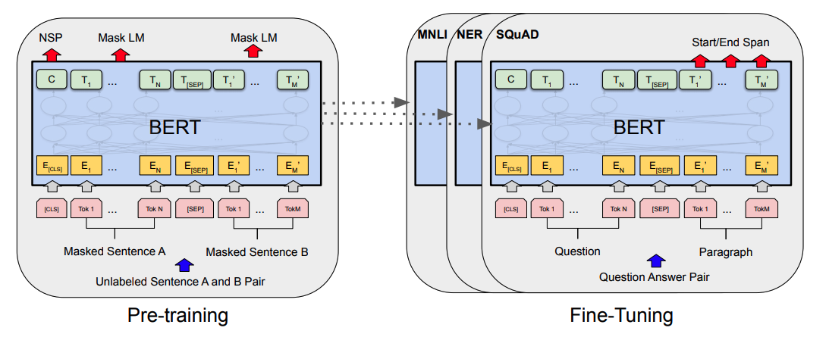
DESIGN AND IMPLEMENTATION
2. Analysis with BERT and Transformers by Hugging Face using Pytorch and Python.
In this step, we preprocess text data for BERT and build a PyTorch dataset which involves tokenization, attention masks, and padding.
Fig: BERT Model

Slide 8
DESIGN AND IMPLEMENTATION
We use Transfer Learning to build a Sentiment Classifier using the Transformers library by Hugging Face.
Later, we evaluate the model on test data.
This is followed by predicting sentiment on raw data.

Slide 9
CONCLUSIONS AND FUTURE ENHANCEMENTS
Train the considered model with more data.
Considering parameter tuning.
Advanced Feature engineering.
Considering other available ML models.
Considering other categories of data for classification.

Slide 10
THANK YOU

